Slide 1
OOPS Project
PLACEMENT ASSISTANCE PORTAL
Sakshi Goenka (180907578)
Arihant Jha (180907582)
Arsh Tangri (180907590)
Saketh Gunnam (151610182)

Slide 2



To assist the students in finding easy Placements and Internships for different Companies that have been registered through the portal.
OBJECTIVE
Unites both the Students and the Companies on a single platform.
Less Paperwork and easy to handle.

Slide 3
Object Diagram
Student
addStudentData(); existingStudentData(); bool check_reg_no();
friend void get_eligible_comps(); friend ostream &operator<<(ostream &out, const student *s);
User
set_Name();
College Admin
int admin_ID;

Slide 4
Company Class Object Diagram
Company
set_company_name(); set_comany_id(); set_location(); set_industry_sector(); set_job_profile(); set_offer_type(); set_category(); set_deadline(); set_cgpa_cutoff(); setXIImarks(); setXmarks(); set_backlogs_allowed(); insertAllBranches();
friend void addCompany() friend void printCompany(); friend void removeCompany(); friend void get_eligible_comps();

Slide 5
Flow Chart
Start
Exit
Student
Choice: Student||College Admin||Exit
College Admin
1.
1.
2.
1.
2.
3.
Remove Company
New Student
Existing Student
Add Company
Print all Company Records
4.
Generate CID
Check ID
False
Print all Student Records
Check Reg. No.
Sets all the Details
False
True
True
Gets all the Company Details
Deletes the Company
Print Student Details
Print all Eligible Companies

Slide 6
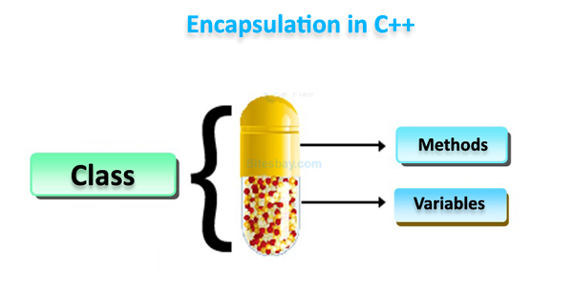
Encapsulation
Encapsulation refers to the bundling of data, along with the methods that operate on that data, into a single unit.
It binds together the data and functions that manipulate the data, which helps in keeping them both safe from outside interference and misuse.
As a result, the use of the “setter” and “getter” functions helps in retrieving and updating the value of a variable outside the encapsulating class.

Slide 7
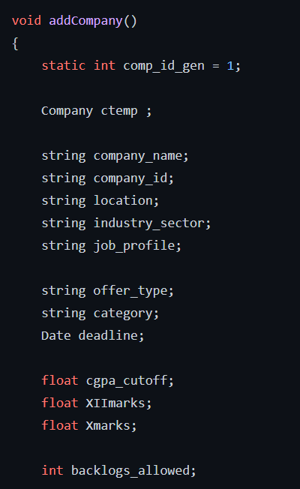
Static Variable
A static variable is a variable that is declared using the keyword static.
The space for the static variable is allocated only one time even if the function is called multiple times and this allocated space is used for the entirety of the program.
The lifetime of a static variable is the lifetime of the program.
We have used the keyword “static” to generate the Company_ID.

Slide 8
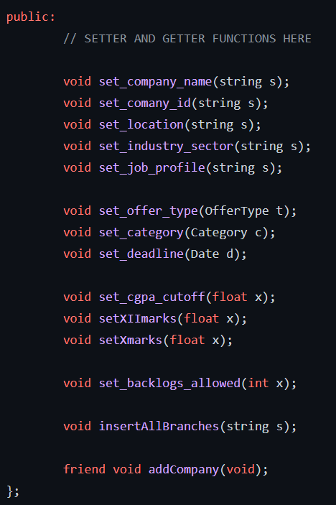
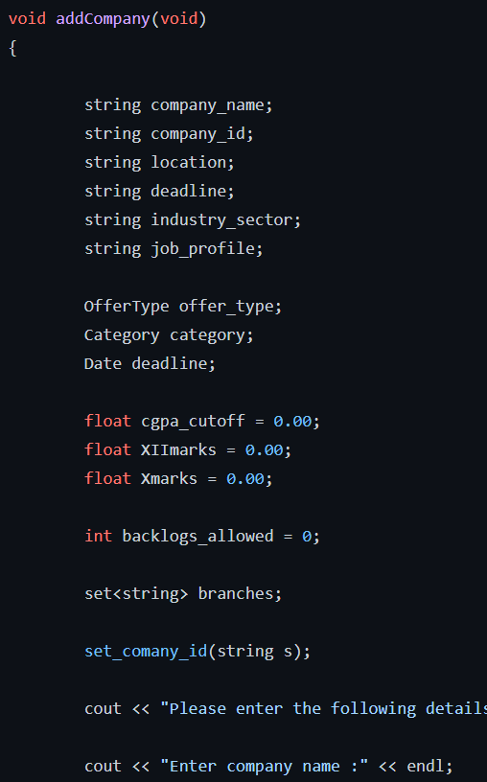
Friend Function
A friend function is given a special grant to access private and protected members of a class.
A friend function can be either be a member of another class or a global function.
Syntax: friend returnType functionName(arguments);
In our case, we have made the function void addCompany() a friend function of the class Company.

Slide 9
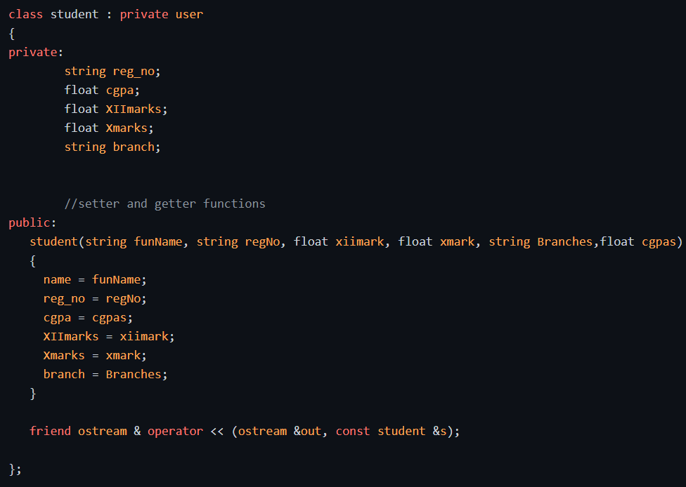
Inheritance
Inheritance is the capability of a class to derive properties and characteristics from another class.
There is a Base class from which the Sub class is able to inherit the characteristics.
Syntax: class subclass_name : access_mode base_class_name
In our code, the “class user” is acting as the base class and the “class student” is acting as the sub class.

Slide 10
Hierarchical Inheritance
User
Student
College Admin
Class Student and the Class College Admin will be inheriting from the Class User

Slide 11
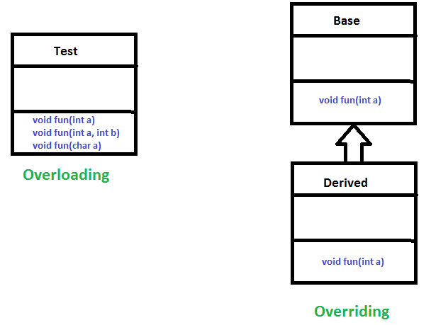
Polymorphism
The word polymorphism means having many forms. It allows us to define one interface and have multiple implementations.
There are two types of polymorphism :- Runtime and Compile time polymorphism
Compile time polymorphism: It consists of operator overloading and function overloading
Runtime Polymorphism: It consists of function overriding.
In our portal we make use of compile time polymorphism to print out class objects and update class X marks based on their education board.

Slide 12
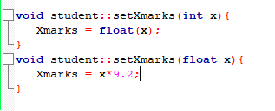
Function Overloading
When there are multiple functions with same name but different parameters then these functions are said to be overloaded.
Functions can be overloaded by change in number of arguments or/and change in Type of arguments.
We are using function overloading in out portal.
It helps us to convert the CGPA of a person into percentage for even comparison.
If the student has scored marks in percentage, we directly store the value in our student object.

Slide 13
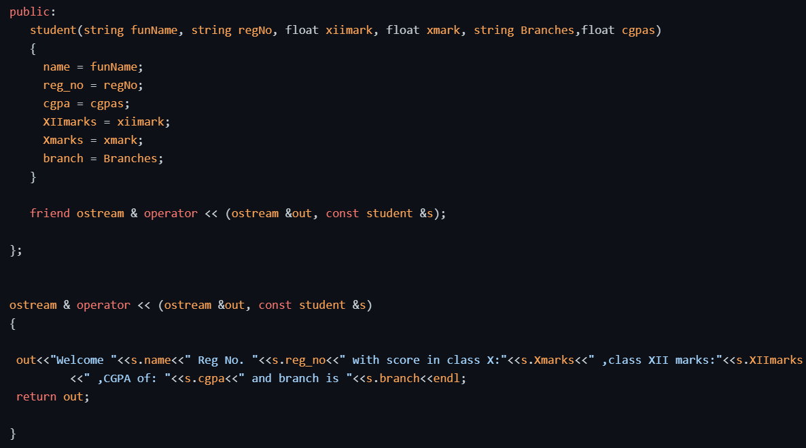
Operator Overloading
Operator overloading is a compile-time polymorphism in which the operator is overloaded to provide the special meaning to the user-defined data type.
Used to overload or redefine most of the operators available in C++.
It is evident from the image that we have overloaded “cout”.
cout is an object of the ostream class and it must be overloaded as a Global function.

Slide 14
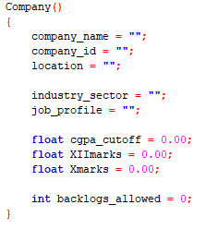
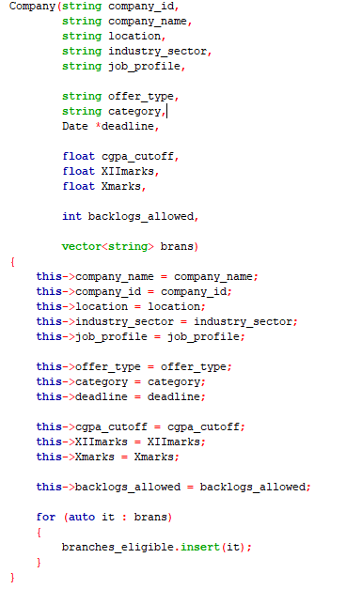
Constructor Overloading
We can have more than one constructor in a class with same name, as long as each has a different list of arguments. This concept is known as Constructor Overloading.
Overloaded constructors essentially have the same name (exact name of the class) and differ by number and type of arguments.
Here we are using two types of constructor for our company class.
One of them is default non parameterized and the other one has all the parameters.
A constructor is called depending upon the number and type of arguments passed.

Slide 15
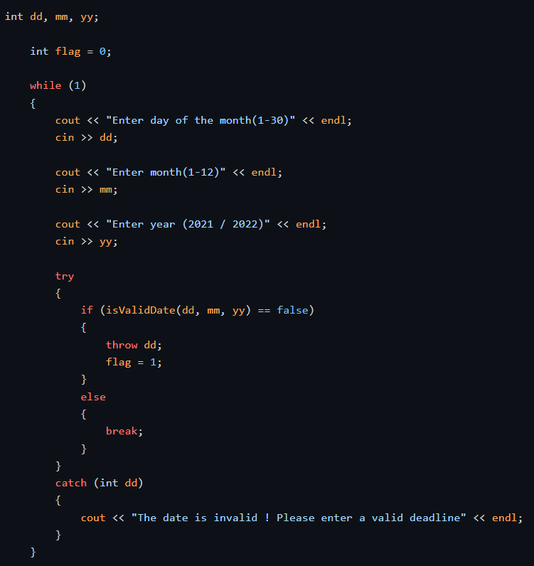
Exception Handling
Exception handling is a mechanism that separates code that detects and handles exceptional circumstances from the rest of your program. As in, when some conditions require specialized processing during the execution of the program.
Consists of 3 Key words: try, throw and catch.
Try and Catch Block

Slide 16
Important Functions
void get_eligible_comps(string reg_no)
bool isValidDate(int d, int m, int y)
void checkStudentData(string rno)
bool student::check_eligiblity(float cg, float twm, float tenm, int BL)

Slide 17
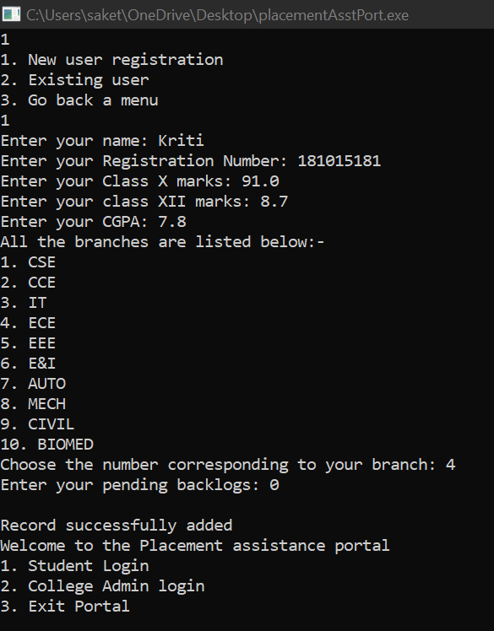
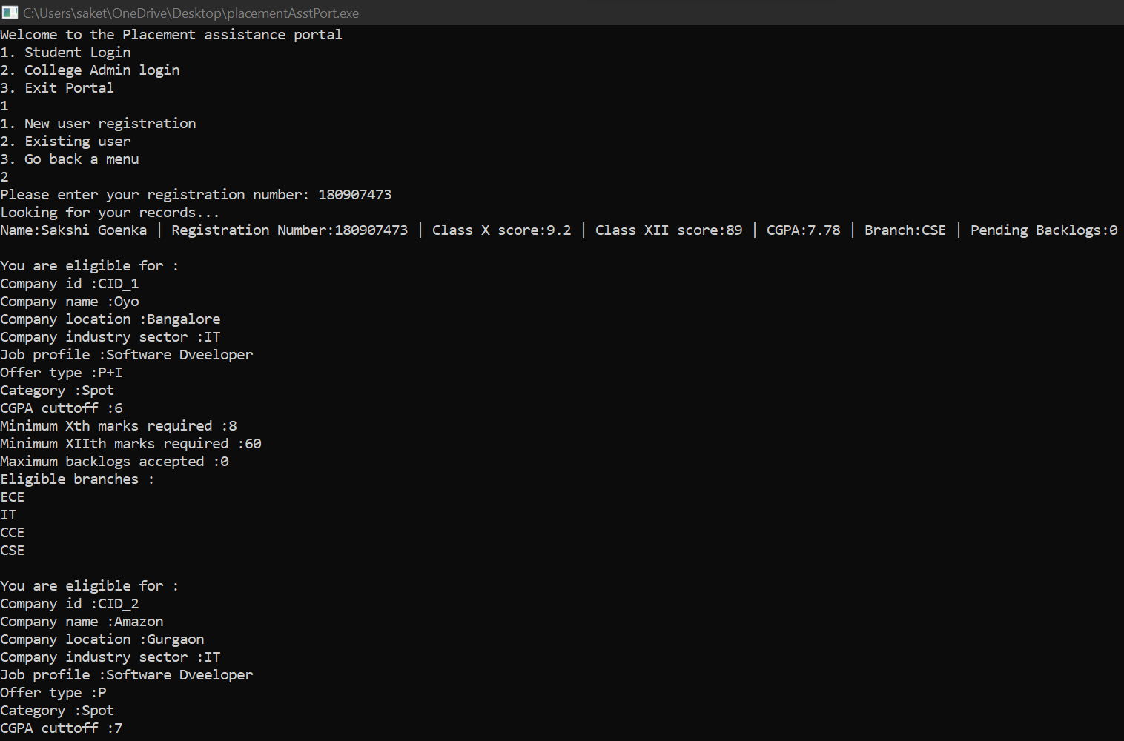
Output
Adding a New Student
Looking up an Existing Student

Slide 18
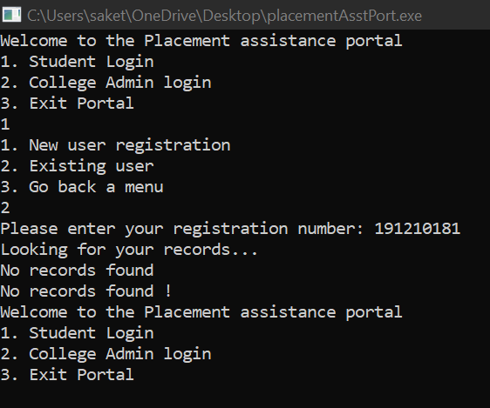
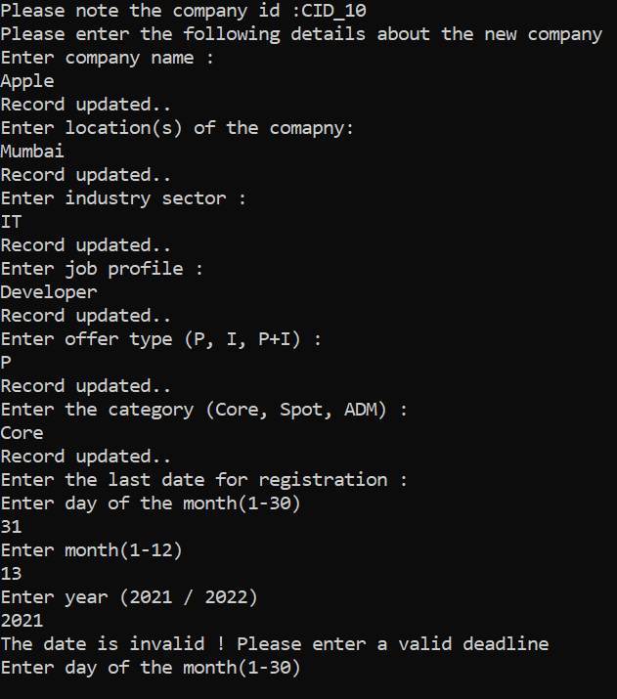
Output(Student records not Found/Deadline Error)
Existing Student records not found
Application Deadline of a Company Error
Application Deadline of a Company Error

Slide 19
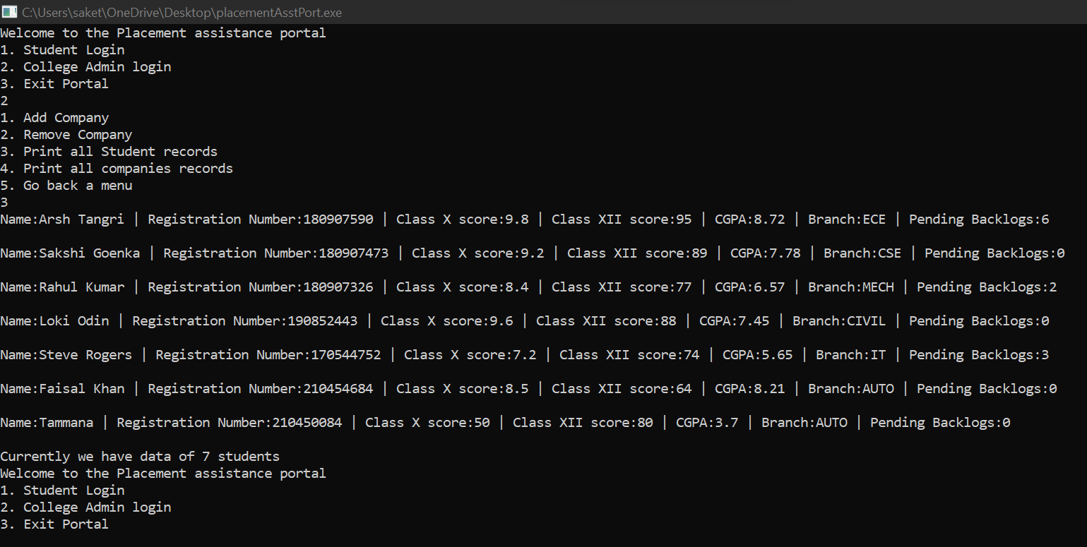
Output(Printing Student Details)

Slide 20
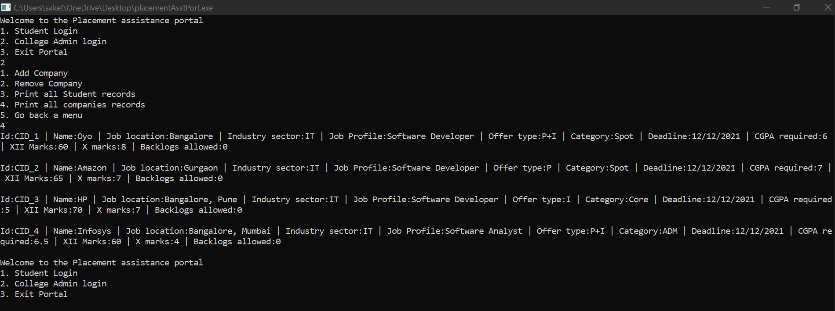
Output(Printing Company Details)

Slide 21
References
https://https://www.geeksforgeeks.org/
https://www.tutorialspoint.com/what-is-the-lifetime-of-a-static-variable-in-a-cplusplus-function
https://www.w3schools.com/cpp/cpp_encapsulation.asp

Slide 22
Thank You

